Slide 1

Chemistry Graduate Program Overview
Course Requirements
Choosing an Advisor
Oral Comprehensive Exam
Thesis Defense
Prof. Jon Tunge:
Director of Graduate Studies (tunge@ku.edu)
1136 GL (ISB)
Ross Perryman:
Graduate Academic Advisor (rossp@ku.edu)
1140 GL (Chemistry Office)

Slide 2
First Semester at a Glance
1) Register for distribution courses, safety and ethics
2) Conduct faculty “interviews”
3) Choose a research advisor
4) Complete an Individual Curriculum Form that details Advanced Courses
5) Choose a Research Advisory Committee

Slide 3
Course Requirements
Distribution Courses:
Complete (with a B or better) two courses selected from the following list of introductory courses in the major areas of study:
CHEM 720 Fundamentals and Methods of Analytical Chem
CHEM 730 Coordination and Organometallic Chemistry
CHEM 740 Principals of Organic Reactions
CHEM 750 Quantum Chemistry and Spectroscopy
CHEM 760 Intro to Chemistry in Biology
Advising available today at 4

Slide 4
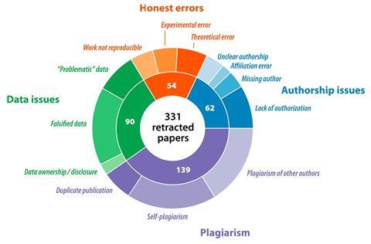
Responsible Scholarship in Chemical Science CHEM700
Misconduct not mistakes are the chief reason chemistry papers are retracted | News | Chemistry World

Slide 5
Responsible Scholarship in Chemical Science CHEM700

Slide 6
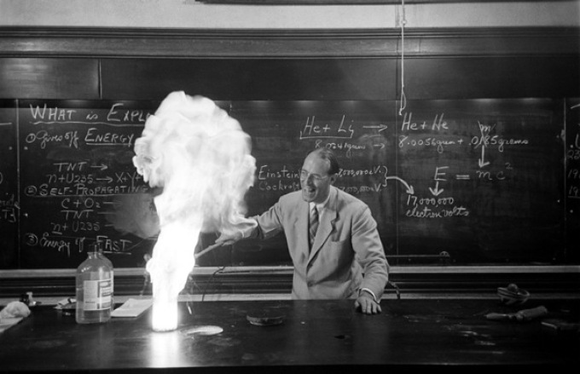
Lab Safety in Chemical Science
CHEM701

Slide 7
Course Requirements
Advanced Courses:
Complete (with a B or better) four courses (700 level or above) in Chemistry or a related area.
The list of courses to be completed must be agreed upon by the student and the student’s research advisor. These courses must be listed in the students’ Individual Curriculum Form and approved by the Graduate Affairs Committee before the beginning of the student’s second semester in the program. (Changes to the list can only be made with the approval of the student, the research advisor, and the Graduate Affairs Committee.)
Note: these four courses represent a minimal set and do not preclude the student, with consultation of their research advisor, from taking additional courses in support of their research effort.

Slide 8
Choosing an Advisor
Choosing your advisor is probably the most important career decision you will ever make, so do it carefully!!!!
You are required to choose an advisor by Nov. 15th, 2025
Things to do…
  Interview Faculty (required to interview at least 4)
  Go to group meetings
  Read recent publications
  Talk to advanced graduate students to find out what life is like in the groups in which you are interested
  Turn in signed interview forms to Ross Perryman by Oct. 15th

Slide 9
Now that you have chosen an advisor…
Meet with your chosen research advisor to develop an Individual Curriculum Plan for courses to fulfill your required coursework and educate you in your chosen area of study. This plan, along with your selection for Research Advisory Committee must be turned in to Ross Perryman by Dec. 1st 2025.

Slide 10
Research Advisory Committee
Your research advisory committee (RAC) should be chosen by you in consultation with your advisor.
  Your advisor + 2 other faculty members
Your RAC is meant to be a resource for you. Your RAC will follow your progress toward Ph.D. and be there as a source of advice. As such, you can call a meeting with your RAC at any time you choose.
You are required to meet with your RAC at least once each year and the committee must submit a brief summary of that meeting to you and Ross Perryman by May 1st.

Slide 11
Comprehensive Oral Examination
The student must deliver a seminar that is attended by their Research Advisory Committee.
5 weeks prior to the Oral Examination you will choose a topic for approval by your Research Advisory Committee
The student must prepare a written, original research proposal.

Slide 12
Comprehensive Oral Examination
The student must deliver a seminar that is attended by their Research Advisory Committee.
5 weeks prior to the Oral Examination you will choose a topic for approval by your Research Advisory Committee
The student must prepare a written, original research proposal.
The proposal must be presented and defended orally at the examination to a committee of five faculty; however, the examination is comprehensive in nature. The student must be prepared for questions on a range of topics in the discipline. Failure to pass the oral examination before the end of the Spring of 2028 of graduate study leads to ineligibility for support by departmental or research funds.

Slide 13
Next Steps…..
research, work, work, work, fail, Get frustrated, something finally works, yeah!, elation, more work, frustration, pain, research, research, research, research, research, research, research, research, advisor mad, research, research, research, research, research, no sleep, research, research, research, research, research, research, research, laugh, research, cry, research, no sleep, research, research, research, research, research, research, research, work, work, experiment failed, ouch!, get frustrated, something finally works, yeah!, elation, back to reality, work, work, fail, get frustrated, something finally works, yeah!, elation, more work, frustration, pain, research, research, research, research, research, research, research, research, research, research, research, advisor happy, research, lab gets flooded – data gone, crap!, research, research, joy, research, research, research, research, research, research, research, despair, research, research, research, done!!!!!!!

Slide 14
Writing your Thesis and Thesis Defense
Your final step is to write an acceptable thesis on your body of original graduate research and defend this thesis in the final oral exam.
Departmental policy requires that this thesis be completed and defended before entering your sixth year of graduate school.
After this step, all we would have to say is
Congratulations, Doctor!!!!!

Slide 15
Year 1

Slide 16
Years 2 & 3

Slide 17

Years 4 & 5

