Slide 1

First-Day
Orientation
Department of
Chemistry

Slide 2

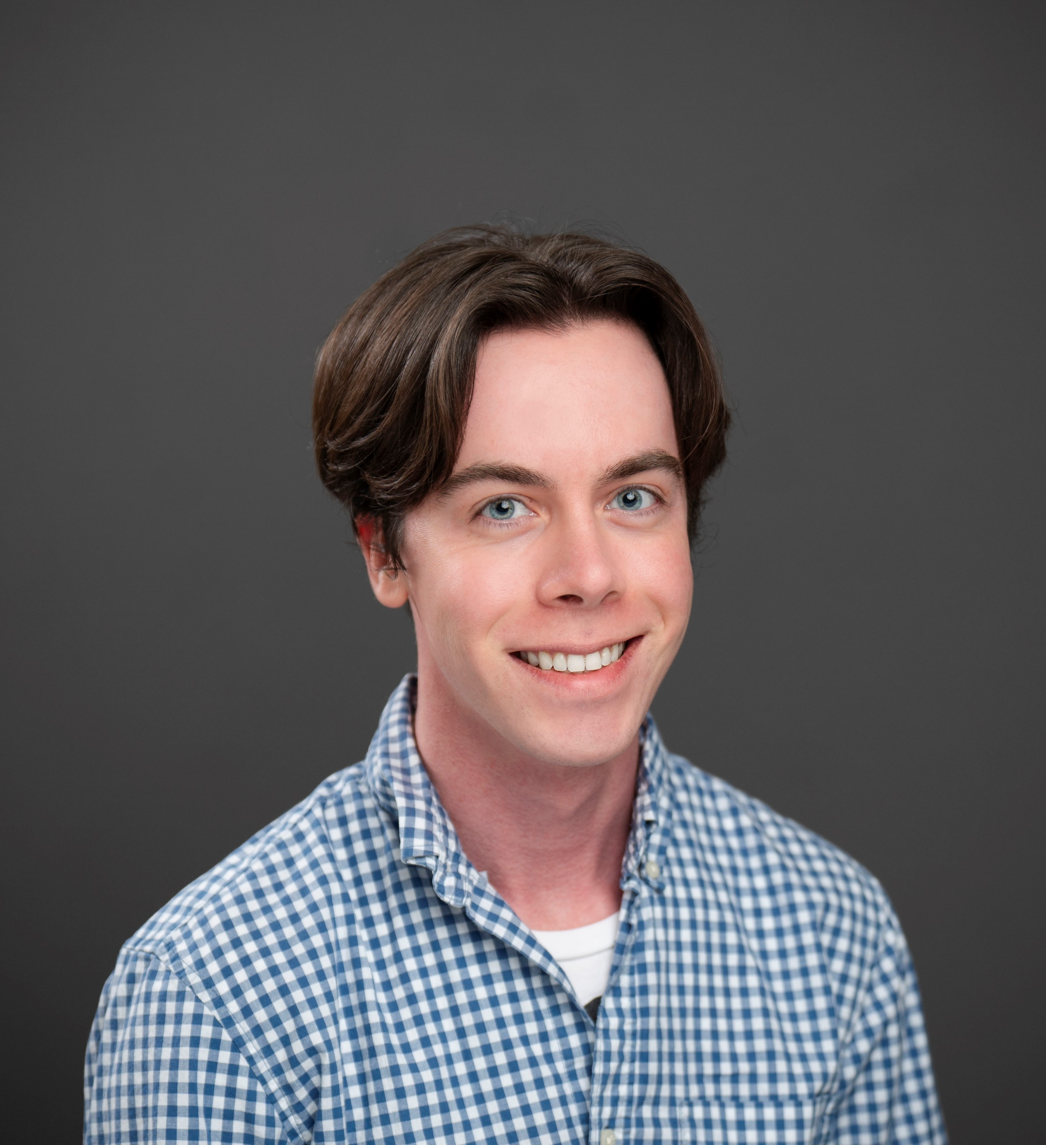
College Office of Graduate Affairs (COGA)
Act as liaison between the Department and the College of Liberal Arts & Sciences
Advise students on University and Departmental policies and procedures
    Enrollment requirements, petitions, leaves, etc.
Track student progress through program
Help schedule oral comprehensive exams and final dissertation defenses
Submit GTA/GRA/GA employment paperwork and provide information about benefits/pay
Graduate Program Coordinator

Slide 3

First
Semester

Slide 4
First Semester - Summary
•••••••••••••••••••••••••••••••••••••••••••••••••••••••••••••••••••••••
        Interview five faculty…………………………………….Oct 15th
        Select Research Advisor………………………………Nov 15th
        Develop Individual Curriculum Plan…………........Dec 1st
        Choose Research Advisory Committee…............Dec 1st

Slide 5
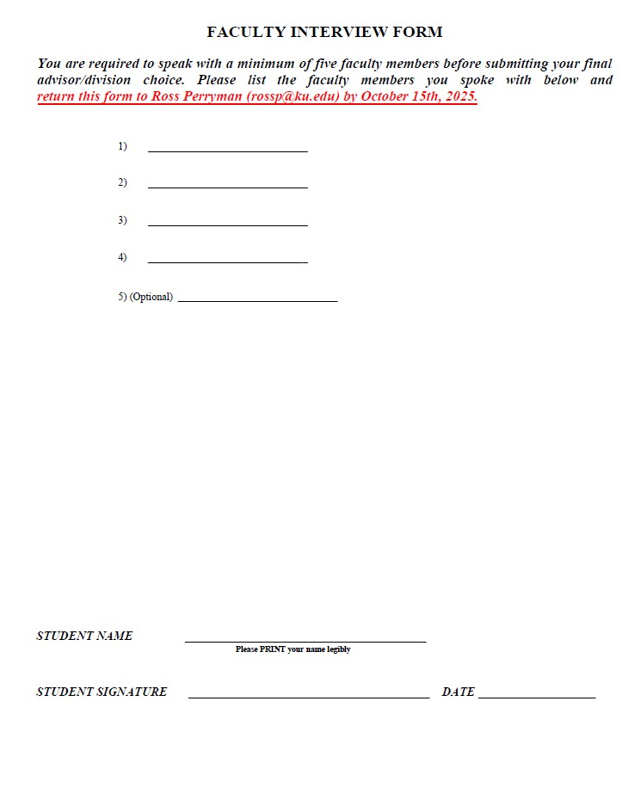
First Semester
••••••••••••••••••••••••••••••••••••••••
Selection of Research Advisor:
Interview at least 4 faculty members and obtain signatures on Form
Return signed form to me by October 15th

Slide 6
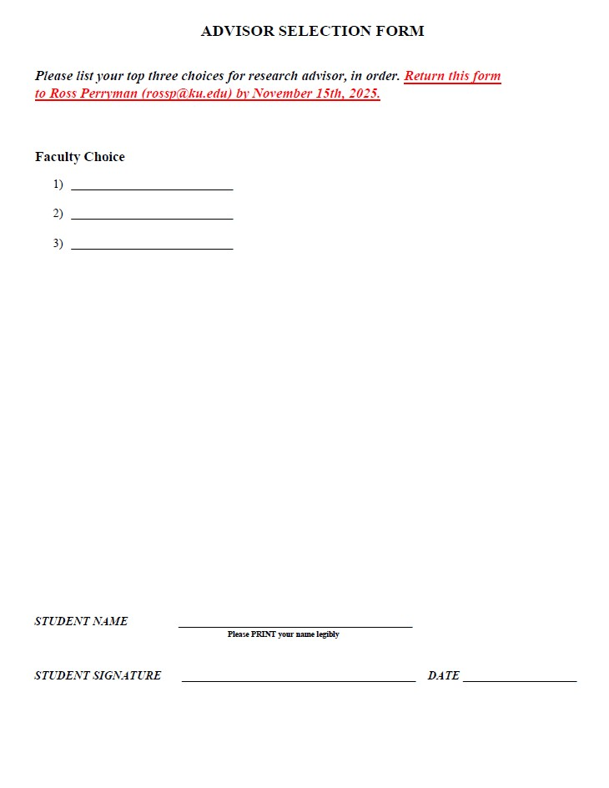
First Semester
••••••••••••••••••••••••••••••••••••••••
Selection of Research Advisor:
Select top 3 advisor choices
Consult faculty member you’d most like to work with and check that they are willing to accept you into their lab
Return signed form to me by Nov. 15th

Slide 7
First Semester
••••••••••••••••••••••••••••••••••••••••
Selection of Research Advisor:
If you decide later to change your advisor, this will need to first be approved by the department
If you decide to change advisors, please talk with me and I can walk you through the petition process

Slide 8
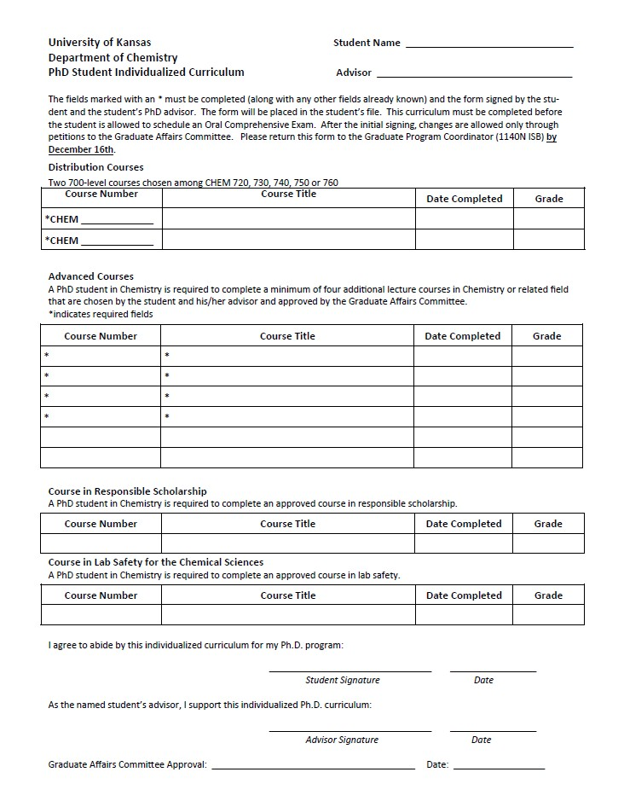
First Semester
••••••••••••••••••••••••••••••••••••••••
Once your research advisor is chosen, you will:
  1. Develop your Individual Curriculum Plan by December 1st
  2. Choose your Research Advisory Committee by December 1st
  (3 faculty members, meet once a year to evaluate your progress)

Slide 9
First Semester - Seminars
•••••••••••••••••••••••••••••••••••••••••••••••••••••••••••••••••••••••
All 1st year students are expected to attend the Departmental Seminars.
  Fridays @ 4:00 PM in GL 1154
You should also plan on attending your divisional seminars!
  Analytical Seminar: Mondays @ 3:30 PM in the Simons Auditorium
  DyMERS Seminar: Wednesdays @ 3:30 PM in GL 1146
  Organic Seminar: Mondays @ 2:00 PM in CDUP 1200
Schedules can be found on website!

Slide 10
Seminars – Directions to West Campus
••••••••••••••••••••••••••••••••••••••••••••••••••••••••••••••••••••••••••••••••••••••••••••••••••••••••••••
West Campus
  MRB: Most bioanalytical faculty labs & offices
  Simons Auditorium: Analytical Seminars
You can easily go between West Campus & Gray-Little Hall via the KU bus system
  Route 42 – Blue
  Lawrence Transit!!! ---- real-time bus info on website and on Passio GO mobile app

Slide 11
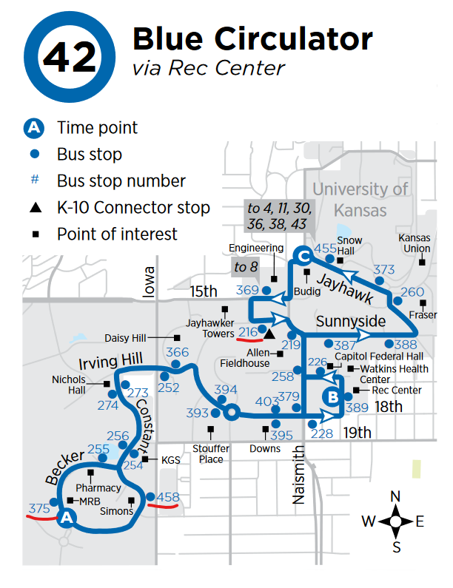
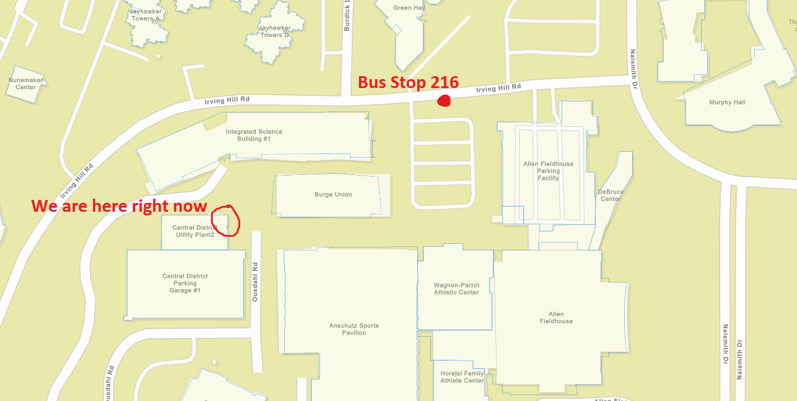
Seminars – Directions to West Campus
••••••••••••••••••••••••••••••••••••••••••••••••••••••••••••••••••••••••••••••••••

Slide 12
First Year Guide
•••••••••••••••••••••••••••••••••••••••••••
You can find ALL THIS INFO on the Guide to the 1st Year webpage – bookmark this page!
  Resources → Students → Graduate → 1st Year Guide
→ PDFs of forms → Enroll & Pay User Guides
→ Important deadlines → Health Insurance Enrollment Info
→ Seminar Times → Bus Route to West Campus
→ And much more!

Slide 13
University
Policies

Slide 14
Academic Probation
••••••••••••••••••••••••••••••••••••••••••••••••••••••••
Good Academic Standing:
  1. Minimum GPA = 3.0
2. Academic and scholarly integrity
3. Completion degree milestones on time (Oral Comp Exam, etc.)
4. Within maximum time to complete program (8 years)
Failure to meet these standards will lead to academic probation during the next semester

Slide 15
Academic Probation
••••••••••••••••••••••••••••••••••••••••••••••••••••••••
The student must increase their GPA up to the 3.0 minimum and return to good academic standing by the end of the probationary semester
Good academic standing is a condition for holding GTA and GRA appointments
The department can petition to keep a probationary student on GTA/GRA for up to one semester
Failure to return to good academic standing may result in a recommendation to end graduate studies

Slide 16
Enrollment Requirements
•••••••••••••••••••••••••••••••••••••••••••••••••••••••••••••••••••••
GTAs/GRAs are required to be enrolled full-time to receive tuition coverage and insurance subsidies
Semester | Full-time Enrollment Minimum
Fall/Spring | 6 hours
Summer | 3 hours

Slide 17
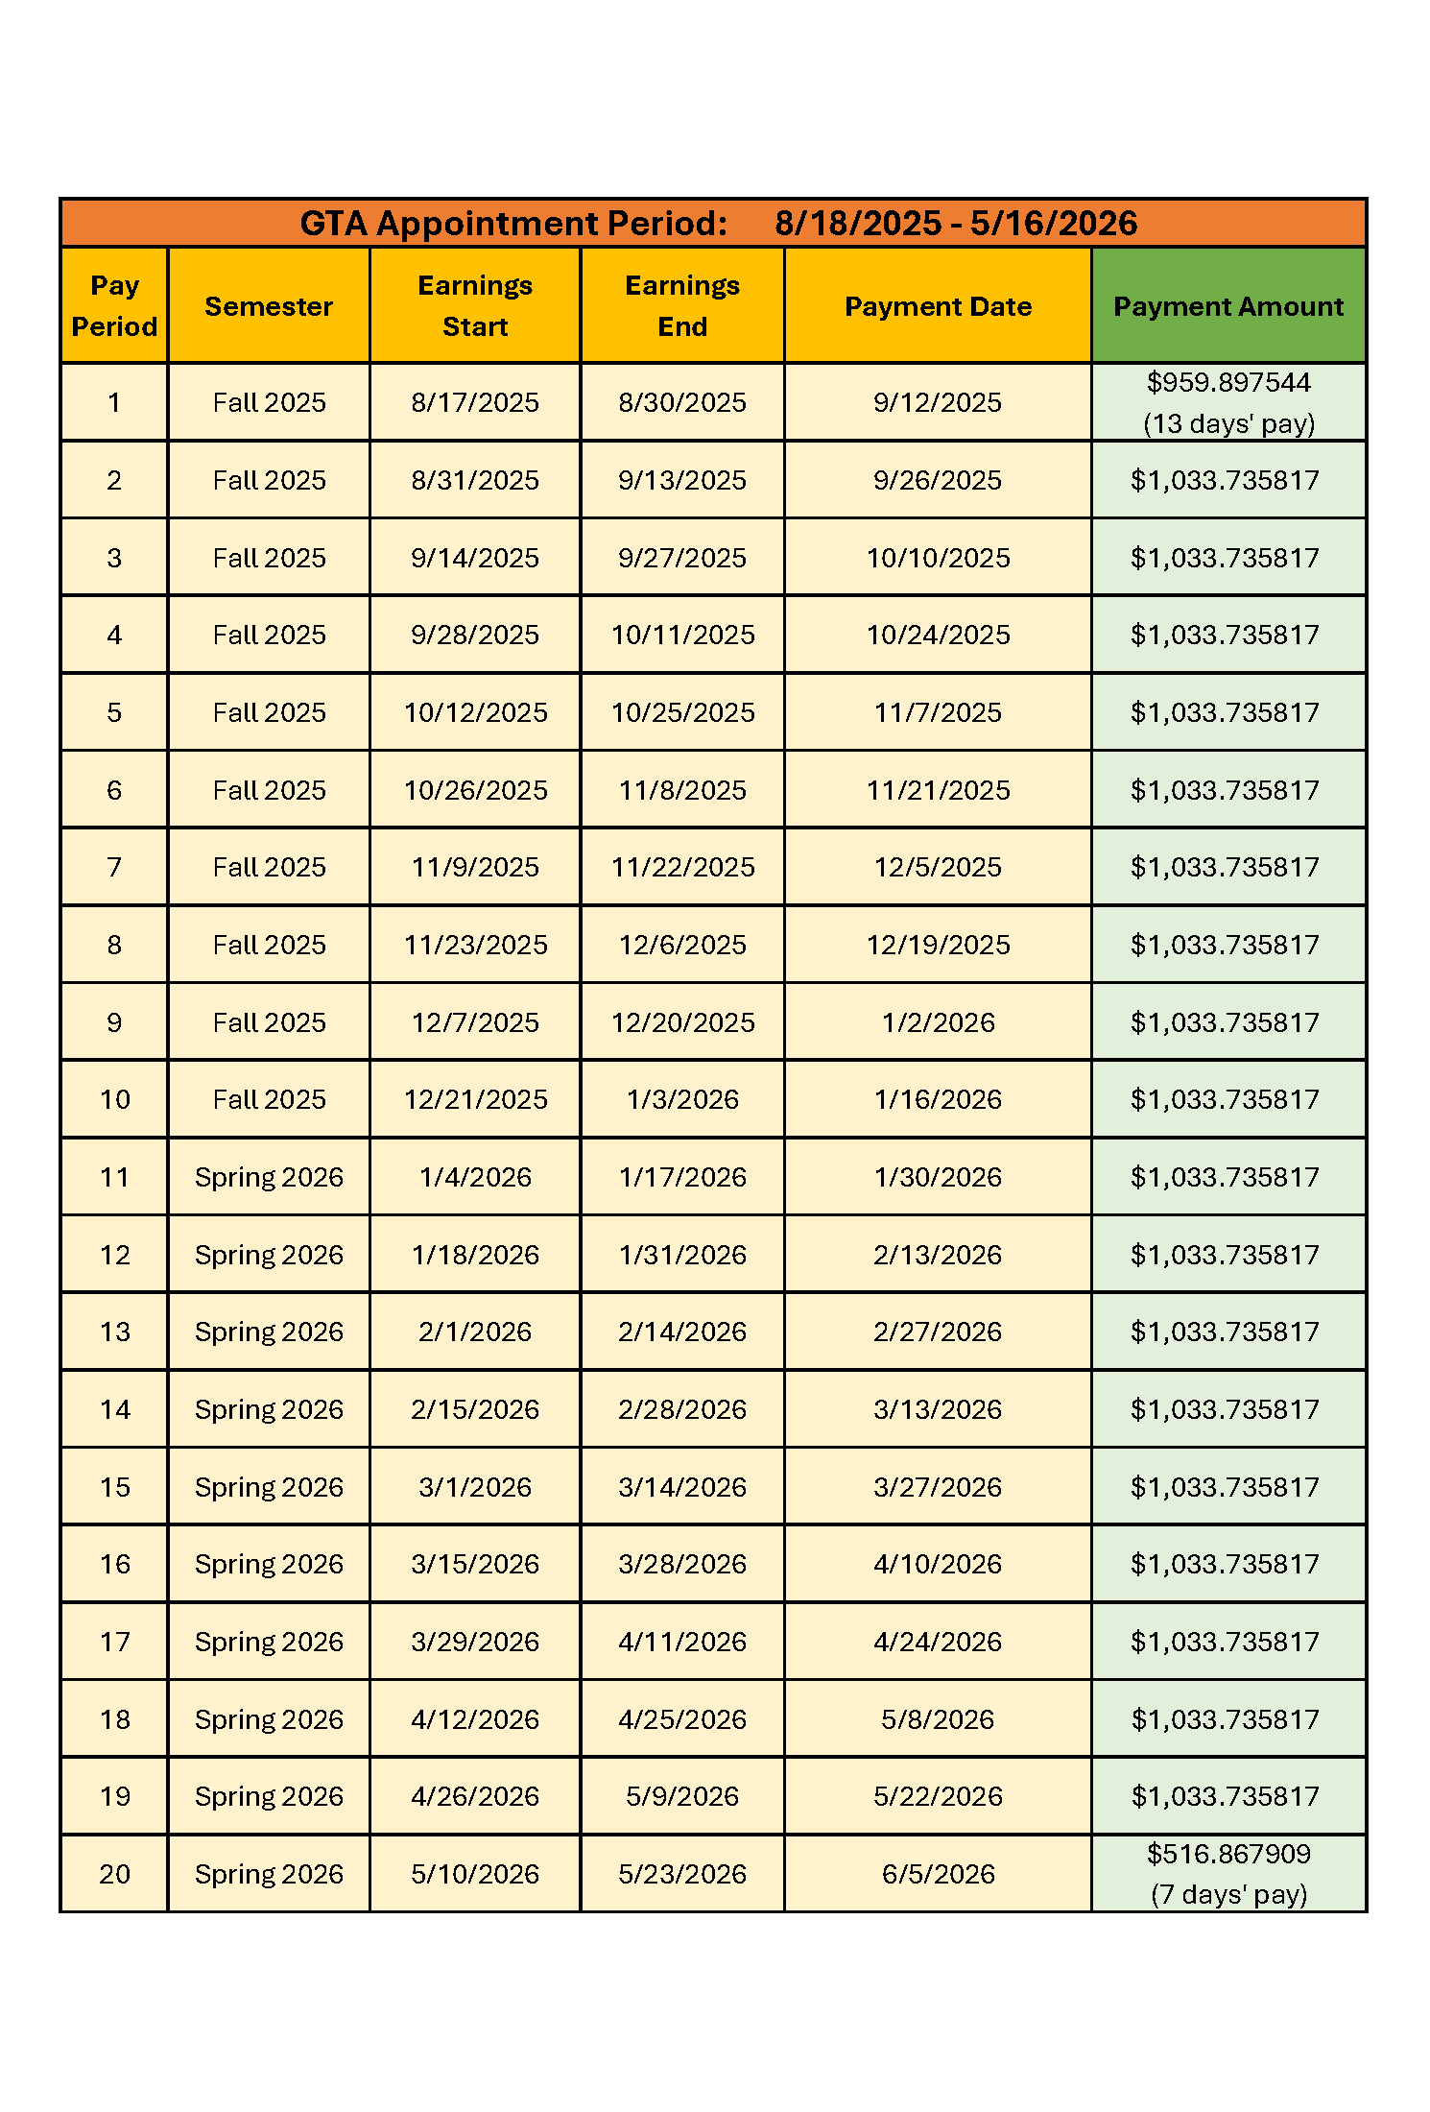
GTA Appointment - Pay
•••••••••••••••••••••••••••••••••••••••••••••••••••••••••••••••••
Pay rate increased to $1,033.735817 biweekly
No gap in pay between Fall & Spring
If you hold a summer GTA, then you will have pay gaps between Spring & Summer and Summer & Fall – we will use short-term GRAs to keep paychecks coming
  I will send out reminders if this applies to you

Slide 18
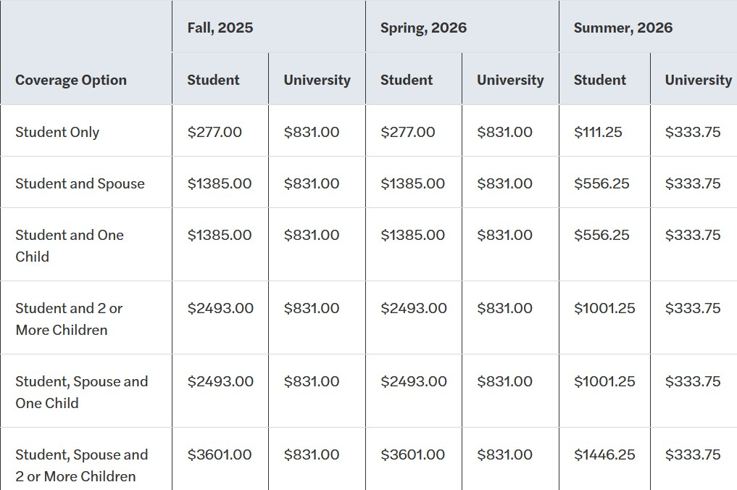
GTA Appointment – Health Insurance
•••••••••••••••••••••••••••••••••••••••••••••••••••••••••••••••••••••••••••••••••••••••••••••••••••••••
All GTAs/GRAs/GAs are eligible for
graduate student health insurance
75% of premium paid by
  University
Enroll by August 26 for
coverage to be retroactively
effective August 1

Slide 19
GTA Appointment – Health Insurance
•••••••••••••••••••••••••••••••••••••••••••••••••••••••••••••••••••••••••••••••••••••••••••••••••••••••
All eligible 50% GTA, GRA and/or GA students can apply for health insurance coverage by submitting an online application at United Healthcare Online Enrollment – need to be enrolled for application to be approved.
Step 1: Once the application has been submitted, the University will verify eligibility and approve the application.
Step 2: Once the application has been approved, the student will receive an email from UHCSR with a link requesting payment of the student's portion of the premium. Enrollment is not complete until UHCSR receives the student's premium payment.

Slide 20
GTA Appointment – Health Insurance
•••••••••••••••••••••••••••••••••••••••••••••••••••••••••••••••••••••••••••••••••••••••••••••••••••••••
This info can also be found on the Chemistry website!
On both pages:
        1st Year Guide
        Graduate Student Resources

Slide 21
Useful KU Sites

Slide 22
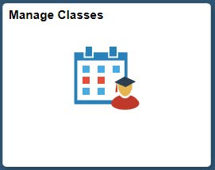
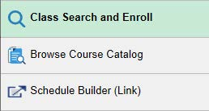
Enroll & Pay
•••••••••••••••••••••••••••
Access Enroll & Pay at https://sa.ku.edu (or through MyKU)
See 1st Year Guide (or handout) for instructions on enrolling in courses
Also use E&P to access bill → “Charges Due”
  → KU Card Fee → Campus Fees
  → Parking Tickets → 25% Health Insurance (Intl)
  Check this regularly! (At least once prior to the start of every semester)

Slide 23
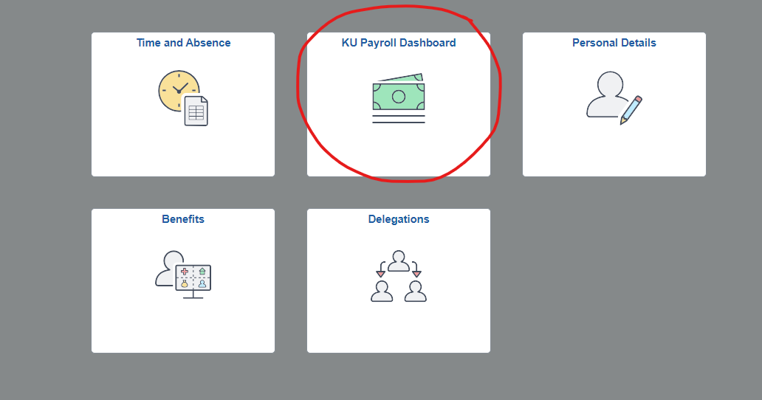
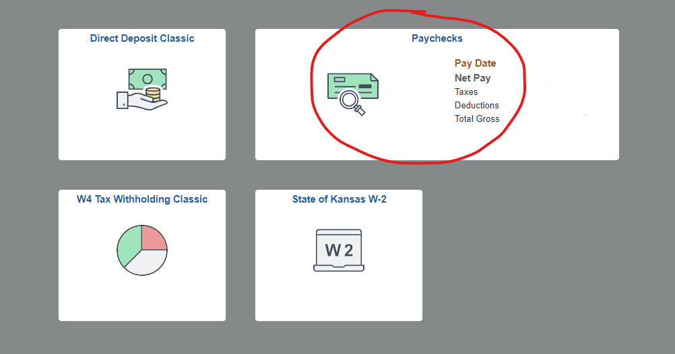
Logging in to HR/Pay
••••••••••••••••••••••••••••••••••••••••••••••••••••••••
You can view your paychecks online at https://hr.ku.edu/
Sign in w/ KU online ID
  → KU Payroll Dashboard
  → Paychecks
You won’t be able to view paycheck the first time you log in – you’ll need to exit and log-in again
Personal Details – update phone #, address, etc.

Slide 24
Resources

Slide 25
Graduate Student Resources
•••••••••••••••••••••••••••••••••••••••••••••••••••••••••••••••
Resources → Students → Graduate → Graduate Student Resources
Info on:
  → Graduate Student Handbook → TA Position Descriptions
  → Travel Awards → Storeroom & Shipping Info
  → Fellowships/Traineeships → Incident Report Form
  → Link to Student Access Center (Academic Accommodations)

Slide 26

University Resources
••••••••••••••••••••••••••••••••••••••••••••••••••••••••••
Graduate Studies Welcome Guide & Info Hub https://graduate.ku.edu/ – Excellent place to start – this site can connect you to many of our campus resources, such as:
  Writing center
  Legal services
  Health and counseling services
  Pregnant & parenting student support
  Conflict management support

Slide 27
University Resources
••••••••••••••••••••••••••••••••••••••••••••••••••••••••••
College Office of Graduate Affairs
https://coga.ku.edu/ :
  University policy questions (enrollment requirements, probation policies, taking leave of absence, etc.)
  Dept. requirements can be more specific
  Recall – this is my office!
  If you ever have questions about these things, please reach out to me!

Slide 28
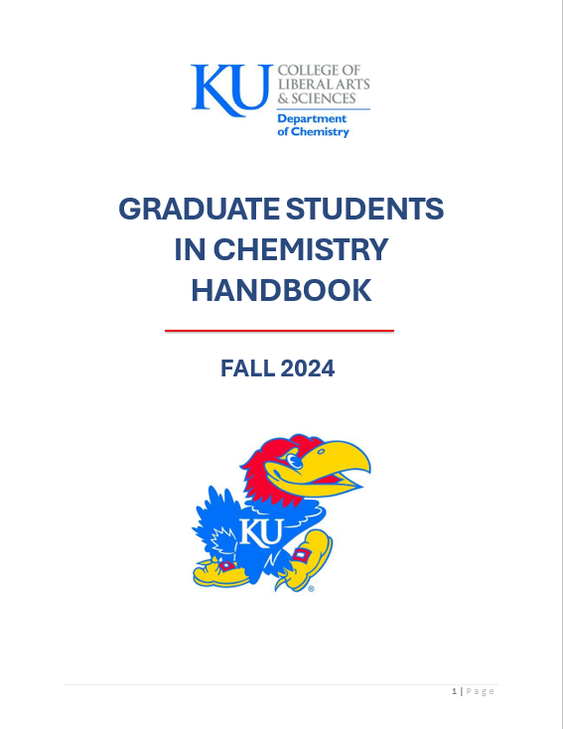
Departmental Handbook
••••••••••••••••••••••••••••••••••••••••••••••••••••••••••••••••••••••
Covers everything Jon and I talked about today!
Can also be found on the Chemistry website!
On both pages:
  1st Year Guide
  Graduate Student Resources

Slide 29
One More Thing!

Slide 30
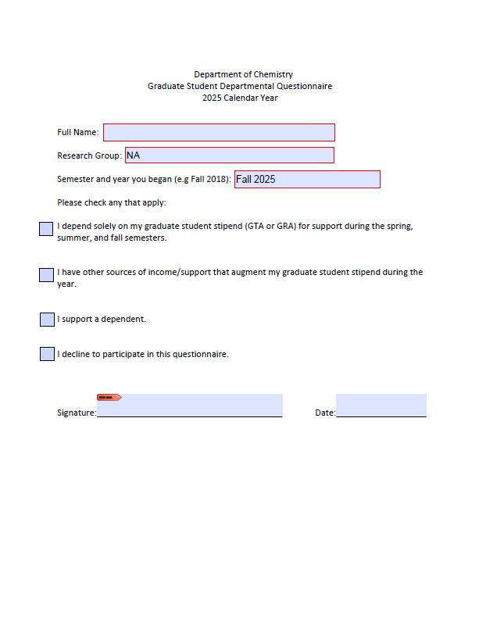
Awards Eligibility Survey
•••••••••••••••••••••••••••••••••••••••••••••••••••••••••••••••••••
Find this in the left-hand side of your folder
We need this info in case the department’s benefactors audit our spending
Fill this out right now!
Return to me before you leave!

Slide 31
First-Day
Orientation
Department of
Chemistry

